Slide 2
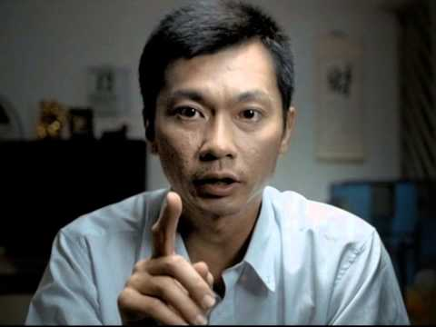

Slide 3
Gambling
Jagan, Shaun, Yan Long

Slide 4
Contents
Problem Statement
Data Handling
Modelling
Results
Conclusion and Recommendations

Slide 5
Does fortune truly favour the bold?

Slide 6
Problem Statement

Slide 7
Problem Statement
Problem Gambling Vs Gambling
Reddit Posts
NLP > Feature Words

Slide 8
Data Handling

Slide 9
Data Handling
Reddit API
Column Selection
Missing Values and Duplicates

Slide 10
Data Handling
Subreddit Mapping
Tokenise
Stopwords
Lemmetisation

Slide 11
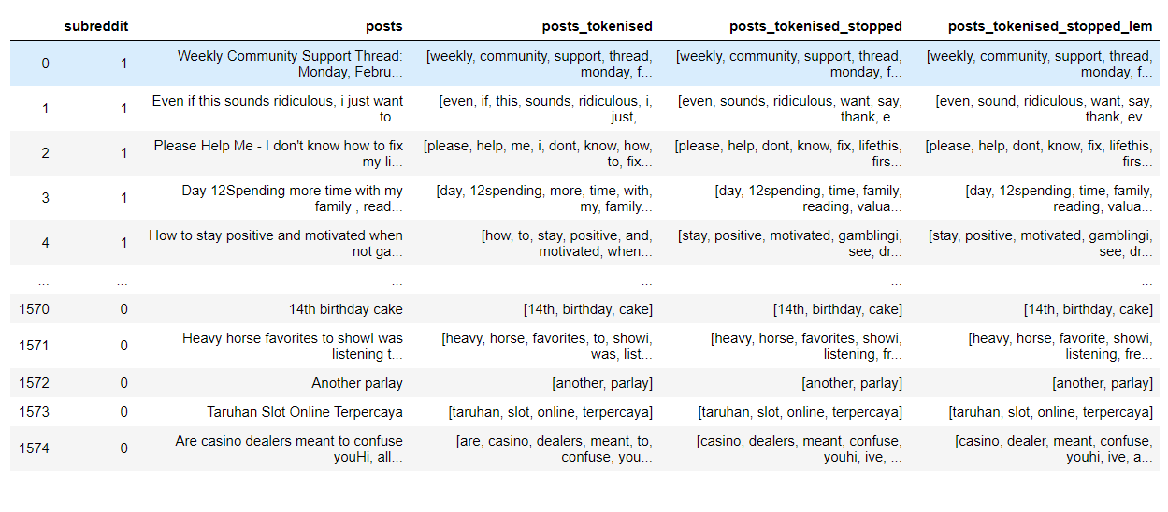
Data Handling

Slide 12
Modelling

Slide 13
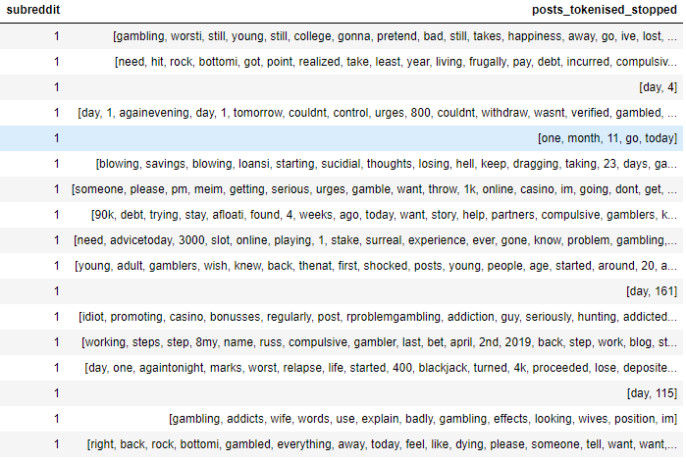
Modelling
TFIDF
MultinomialNB & Logistic Regression
Post: Gambling like an idiot, i am in debt -> [gambling, idiot, debt]

Slide 14
Results

Slide 15
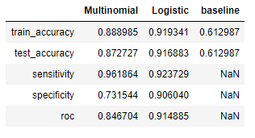
Results

Slide 16
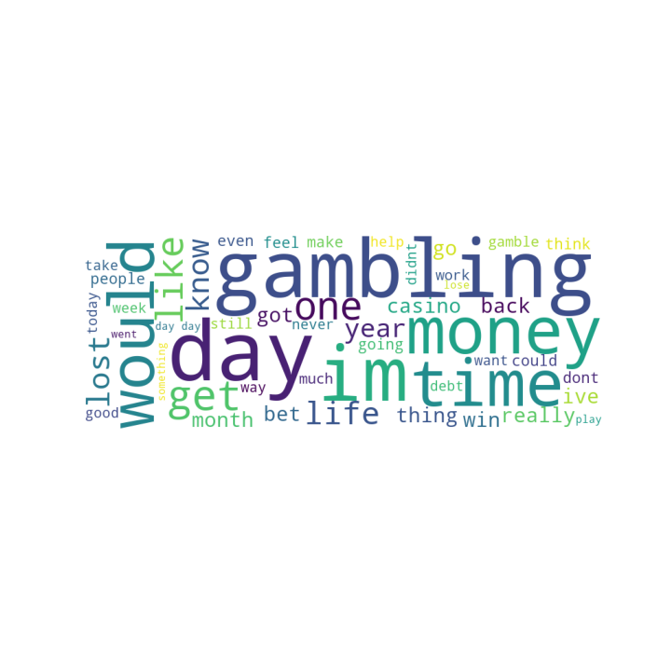
Results

Slide 17
Conclusion

Slide 18
Conclusion
Selected Vectoriser:
TF-IDF
Selected Model:
Logistic Regression
Notes:
Higher AUC indicates a higher True Positive Rate and a lower False Positive Rate
As seen from visualisation at the optimal AUC, the distribution for the 2 possible outcomes are clearly distinct

Slide 19
Conclusion
Build Model
Classified Subreddit Successfully
NOW WHAT??
Extract the words with higher coefficients for gambling and problem_gambling
Words → Basis of investigation to develop recommendations for gambling addicts

Slide 20
Recommendations

Slide 21
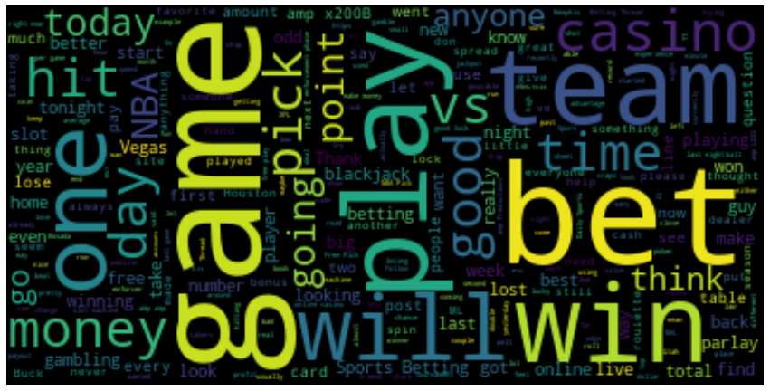
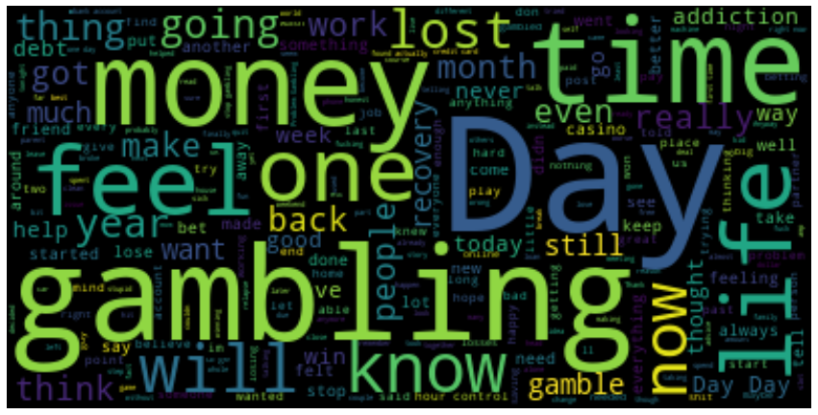
Recommendations
Notes:
Explain the wordplots, left is for gambling and right is for problem gambling.
Specify the key words (game, win, money, one, today) (money, time,lost,day,feel,life,time)

Slide 22
Recommendations
Observation 1: Money has a larger presence in problem_gambling compared to gambling subreddit.
Gambling leads to Financial Difficulties → Problem Gambling
Gamblers are not solely driven by money, the thrill factor plays a major role → Appears lesser in gambling
Observation 2: Words of a shorter term like today have a higher representation in gambling over words of longer term like month and year
Gamblers yearn for instant gratification
Long term words → long term thoughts on recovery
Identify and link up those who are rehabilitating
Notes:
Findings of Project
How we hope to use these findings to apply to stakeholders
What we are actually gonna do with the findings

Slide 23
Recommendations
Observation 3: Emotional words like feel and lost are in the problem_gambling subreddit.
The type of feelings can be studied to develop a more customised format of counselling to aid those in distress
Note:
As always the optimal solution to better modelling is to get more data
Reddit != Local problems
Posts may not always be reliable
Use words from reddit to construct a detailed quiz for those facing gambling addiction locally
Notes:
Findings of Project
How we hope to use these findings to apply to stakeholders
What we are actually gonna do with the findings

Slide 24
